Slide 1
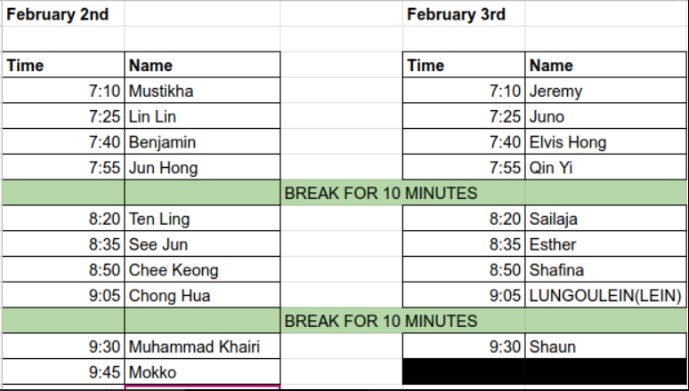
Notes:
Presentation List.

Slide 2
Zoom Screen Test
Notes:
If you can read this note, I am screwed!

Slide 3
An analysis of Singapore rainfall and temperature in the Year 2022.
Notes:
What are you trying to do? I removed my notes, haahaa.

Slide 4
Role
    Data Analyst for Government Projects on environmental matters.
    Extract datasets from government sources only.
    Transform and load datasets into a Dashboard for visualization.
    Visualize the Rainfall trend.
    Visualize the Air Temperature trend.
Notes:
What are you trying to do? I removed my notes, haahaa.

Slide 5
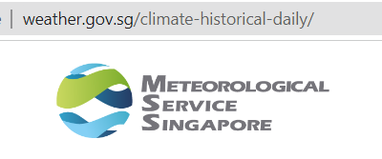
Raw data
    Source: Meteorological Service Singapore (MSS) http://www.weather.gov.sg/climate-historical-daily/
    Downloaded 192 files (CSV format)
    (16 weather stations x 12 months each)
    After merging, the dataset contains 5840 records.
Notes:
What are you trying to do? I removed my notes, haahaa.

Slide 6
Cleaning & Transforming
Data
Notes:
What are you trying to do? I removed my notes, haahaa.

Slide 7
What are the changes?
    Merged 192 CSV files into one dataset.
    Remove unwanted columns (e.g. Source. Name)
    Create a new column using a custom formula
    =#date[Year],[Month],[Day]
    =xlookup(… …)
    Change Column Type to DATE
    Create a new column to COUNT rainy days
    Create a new column to rank the stations with the highest temperature.
Notes:
What are you trying to do? I removed my notes, haahaa.

Slide 8
Dashboard Demo
switching to Excel screen…
Please wait patiently… …
Notes:
What are you trying to do? I removed my notes, haahaa.

Slide 9
Thank you
Notes:
What are you trying to do? I removed my notes, haahaa.

Slide 10
Q & A
Notes:
What are you trying to do? I removed my notes, haahaa.

